Slide 1
Utilizing the OBHHAP deeds database
Structuring unstructured data & navigating an open-source deeds database
Jeff Burnett

Slide 2

What is the OBHHAP deeds database
The Oak Bluffs Historic Highlands Archaeology Project deeds database is the primary repository for deed, census, and archaeological data for Jeff Burnett’s dissertation research project in Oak Bluffs, MA.
The OBHHAP is a landscape history and archaeological study of the historic Vineyard Highlands area of Oak Bluffs, a geographic area recognized as being an important site of African American history and culture on Martha’s Vineyard.
The database was created using Michigan State University’s open-source KORA database code (https://matrix.dev.matrix.msu.edu/projects/kora/).
Notes:
The Oak Bluffs Historic Highlands Archaeology Project deeds database is the primary repository for deed, census, and archaeological data for Jeff Burnett’s dissertation research project in Oak Bluffs, MA. The OBHHAP is a landscape history and archaeological study of the historic Vineyard Highlands area of Oak Bluffs, a geographic area recognized as being an important site of African American history and culture on Martha’s Vineyard. The project works to reconstruct the historic community from 1870 to the 1950s through deed and census records.
The database was created using Michigan State University’s open-source KORA database code (https://matrix.dev.matrix.msu.edu/projects/kora/). The platform allows multiple users to enter, search, and export data simultaneously. It also acts as a geodatabase, when records are exported as commas separated value (csv) files and joined with geospatial data. In this presentation we will introduce the database and how to navigate it

Slide 3
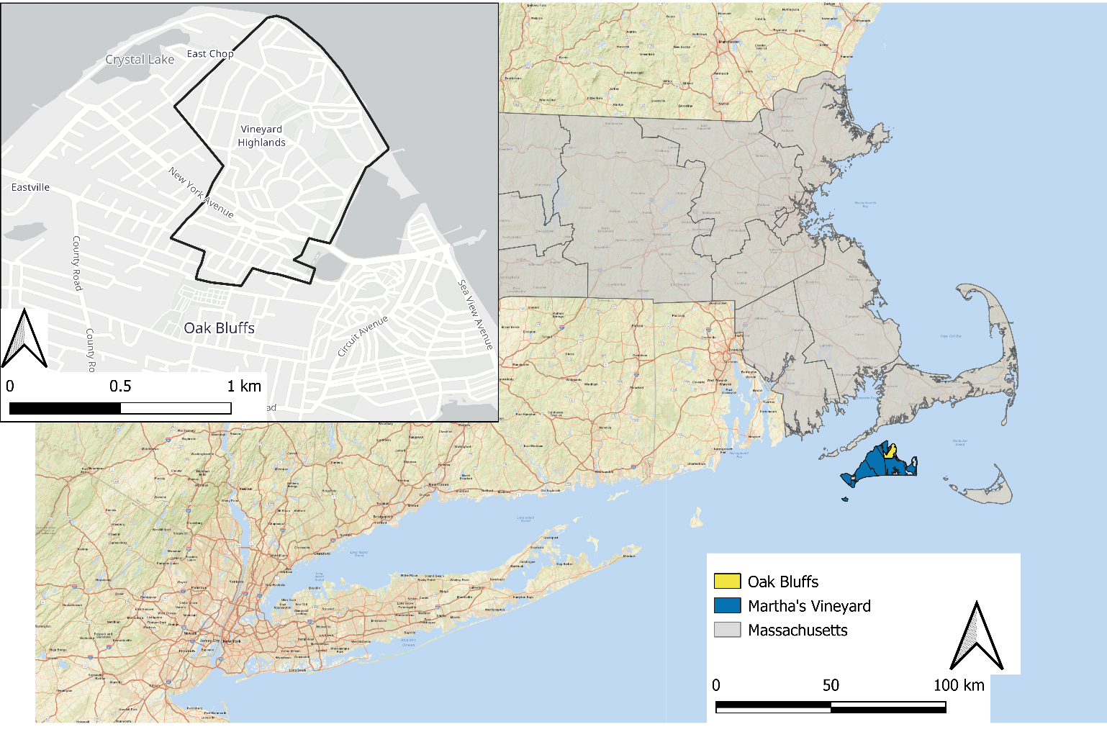

Slide 4
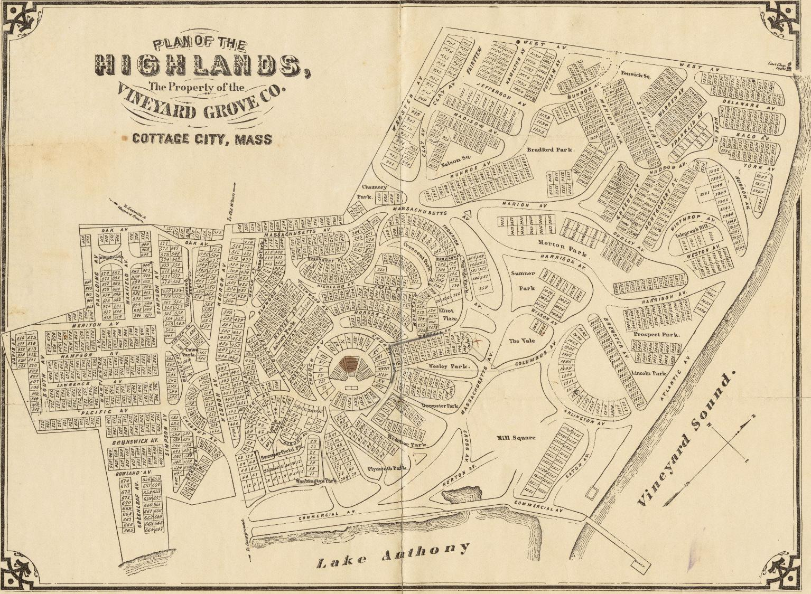
Map of lots and parks plotted in the Vineyard Highlands, ca. 1890
Image Courtesy of Leventhal Map & Education Center at the Boston Public Library

Slide 5
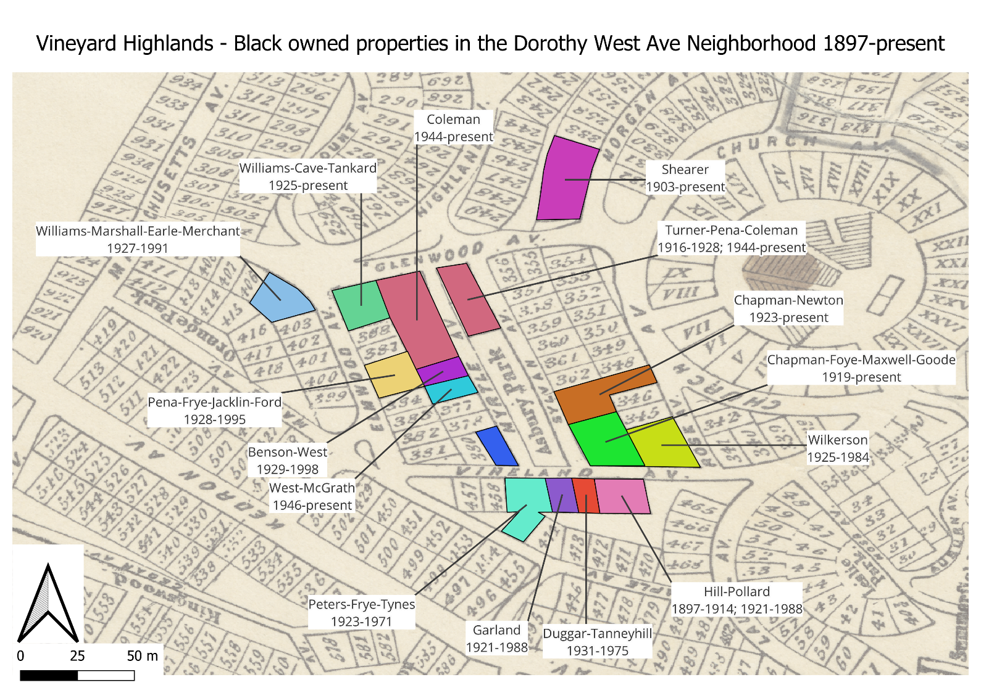

Slide 6
What are the benefits of a “robust” platform?
Building on community-based archaeologies of the African Diaspora, particularly projects that position archaeologists as working for local communities (Jenkins 2022) or archaeology as a way to disrupt white nationalist heritage tourism (Reid 2022)
Also engages of radical abundance in historic preservation and cultural heritage work which seek to reorientate the field away from capitalist understandings of preservation as enclosure towards preservation as empowering communities to assert control over meaningful places, belongings, and historical narratives.
We hope that this project will increase familiarity and collaboration among local heritage organizations, facilitate broad engagement with significant sites, and help empower individuals and organizations to build a heritage landscape that represents the historic and contemporary communities, regardless of who owns the site.
Notes:
The work of the Historic Highlands project and the deeds database connects to Dr. Christopher Matthews’ articulation of a People’s Preservation. Matthews (2020) notes that the goals and criteria of the National Register can overdetermine what is deemed historically significant heritage, valid preservation practices, and threats to heritage sites in a community. Matthews argues that efforts to solicit the participation of historically excluded groups without fundamentally changing the logics of historic preservation work primarily to enclose these histories with little or no benefit to local communities.
Some of the Oak Bluffs community members who visited the site told us they routinely walked through it, some knew of the park but remembered it as overgrown and inaccessible, and others had no idea the park or the historic foundations existed, even if they had heard of the Baptist Tabernacle. This is in part because the park is not an official site on the African American Heritage Trail of Martha’s Vineyard and there are no signs promoting the park as a historical site or accessible greenspace.
Our interviews with community members revealed a different understanding, however, that for decades Baptist Temple Park and the Tabernacle was a known and recognized place in the Highlands. Interviewees recalled the space as a childhood play area and short-cut; as a place where family members rushed to in the middle of the night to help a woman living illicitly in the park give birth; the place they or their families attended religious events; a wooded place to avoid.
Due to the work of the project, the organization who owns the park is now planning to add an informational sign in the park detailing the history of the Tabernacle and some of the findings from the project. African American community members and heritage organizations expressed a desire to ensure that the information reflects their voices - but the plans are in their earliest stages and the private landowner group is not required to consult with residents. This reflects a fundamental tension in cultural heritage work in Oak Bluffs, where nearly all the historically significant sites are privately owned. It is possible to reshape the heritage landscape quickly – sites can be added to the heritage trail if the owners and the Trail agrees to add them or a sign can be added to a historically significant park but without public oversight, there remains significant gaps. I hope that this project will increase familiarity and collaboration among local heritage organizations, facilitate broad engagement with significant sites, and help empower individuals and organizations to build a heritage landscape that represents the historic and contemporary communities, regardless of who owns the site.

Slide 7
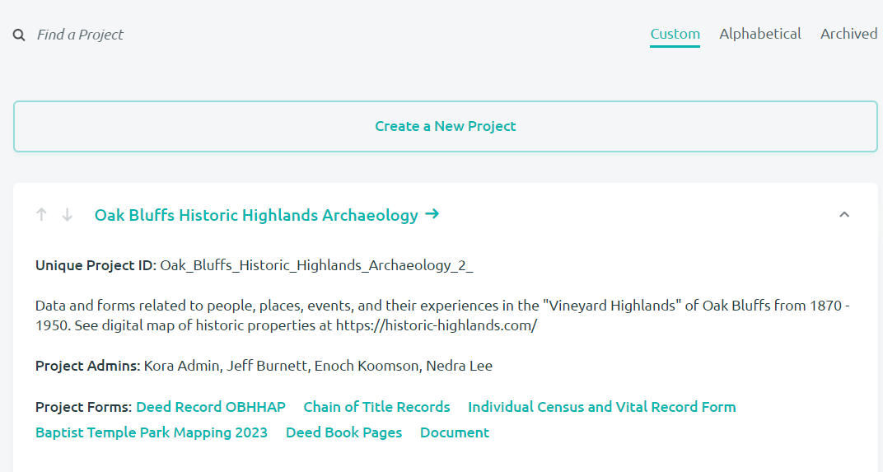
How to navigate and engage with the database
Deed Record Form
Chain of Title Form
Deed Pages Form

Slide 8
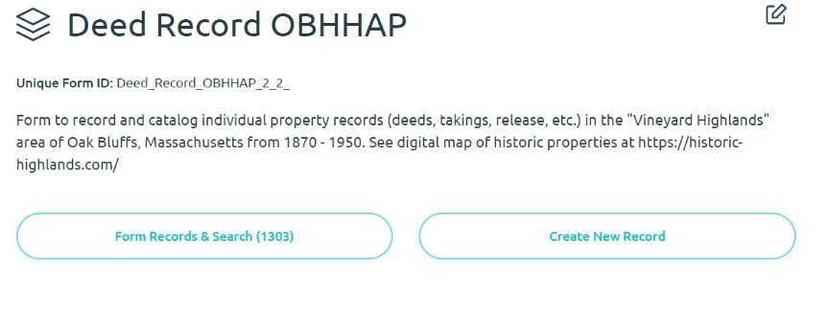
Deed Record Form
Navigate to the OBHHA project through the KORA website and select the Deed Record form. There will be two oval buttons at the top of the form: “Form Records & Search” and “Create New Record”.
Select “Form Records & Search” to begin searching deed records

Slide 9
Deed Record Form
Information included in the deed record form:
  Lot Number – which corresponds to the historic property maps
  Deed summary - a short, conversational account of the transaction
  Transaction date and Year
  Presence of a discriminatory restrictive covenant
  Associated Deed Record Pages - deed pages uploaded into the KORA database
  Grantee / Grantor Racial Categorization
  Additional grantee demographic information - a text box with other demographic and contextual information
  Associated Chain of title - a link to the chain of title record created for the property in KORA.

Slide 10
How to navigate and engage with the database
Deed Record Form
Chain of Title Form
Deed Pages Form

Slide 11
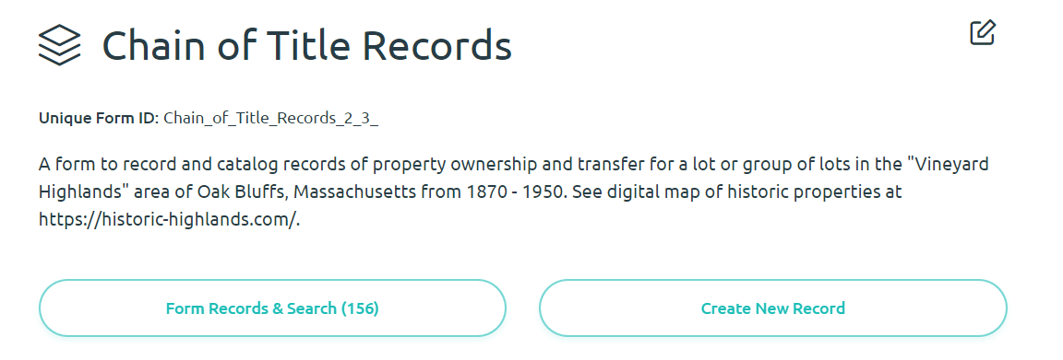
Chain of Title Form
This form summarizes the property history of a lot / group of lots regarding those who lived at the property, who purchased and sold the property, and any other important information necessary for understanding the site and the people who lived there.
Navigate to the OBHHA project through the KORA website and select the Chain of Title Records form. There will be two oval buttons at the top of the form: “Form Records & Search” and “Create New Record”. Select “Search” to begin searching the chain of title database.

Slide 12
Chain of Title Form
Information included in the chain of title record form:
  Property Identifier - the name given to the property.
    The name represents the people most significant to the history of the property and is a judgment call based on what we know.
  Lot numbers
  Address – present day address of the property
  Property history - a narrativized history of the property told through deed, census, secondary, and other sources which highlights the people who owned and may have lived at the property
  Chain of title summary - a bulleted list of land transfers as recorded in the deed records.
  Restrictive Covenant & Year a Restrictive Covenant was added
  MHC Inventory Form – if the property is included in the state historic property inventory the ID number and form will be attached to the COT form

Slide 13
How to navigate and engage with the database
Deed Record Form
Chain of Title Form
Deed Pages Form

Slide 14
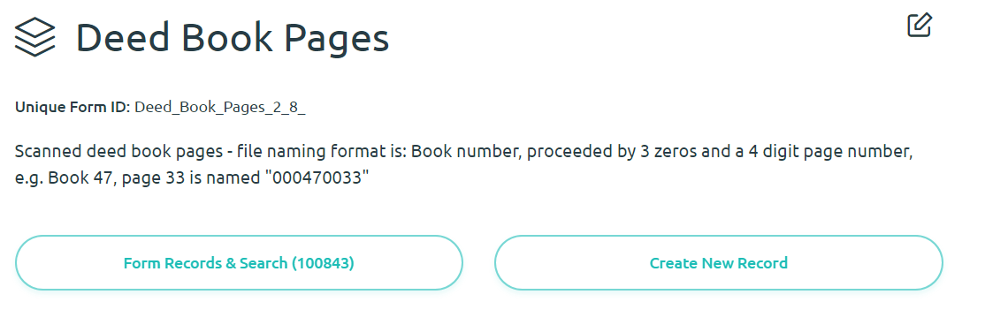
Deed Pages Form
Digitized deed book pages, searchable by book and page number
  Books given a 5 digit id & pages given a 4 digit id – following ROD standards
  To find page 500 in Book 80, search for “000800500”
Mainly to allow deed book pages to be linked to deed records

Slide 15
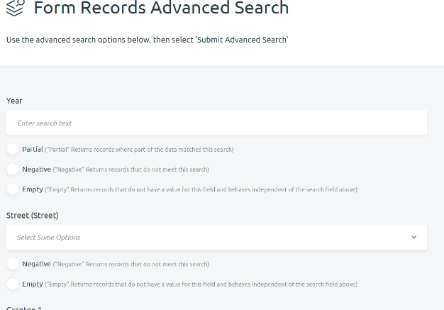
Advanced Searching
Both the deed record and chain of title are searchable by information in specific categories
After selecting the original search box, you can select “Go To Advanced Search”
After selecting the variables you wish to search for, scroll down to the bottom and select “Submit”
The search will pull information that matches what is entered
  Selecting “partial” in the Lot section of the deed records form allows searching for all deeds that contain lot “0035”
  Selecting negative will pull the opposite
  Selecting empty will pull all records with no data in that category

